Slide 1

Activities of the WMO Commission for Climatology (CCl)
Standards for Hazard Monitoring, Databases, Metadata and Analysis Techniques to Support Risk Assessment
G. Srinivasan
on behalf of CCl
First Technical Workshop on Standards for Hazard Monitoring, Databases, Metadata and Analysis Techniques to Support Risk Assessment
WMO, Geneva, 10-14 June 2013

Slide 2
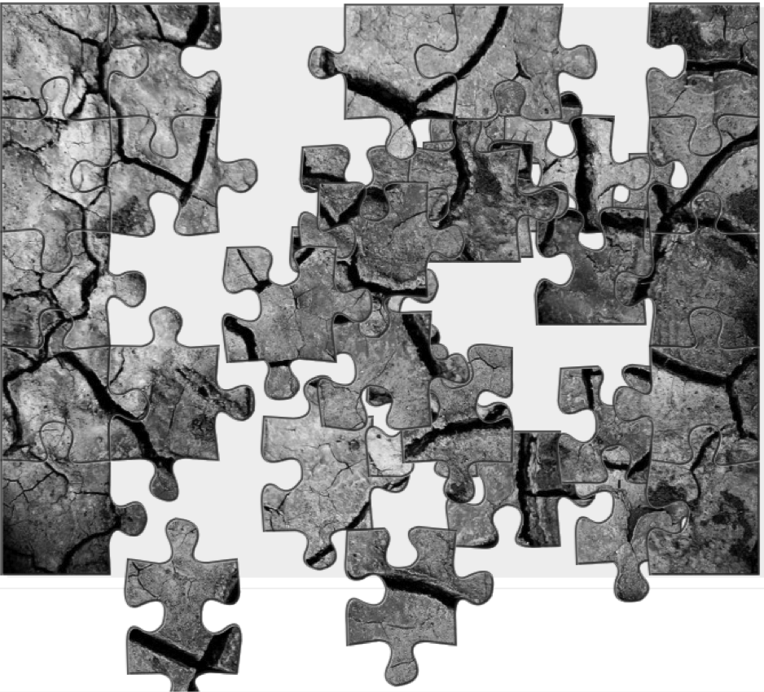
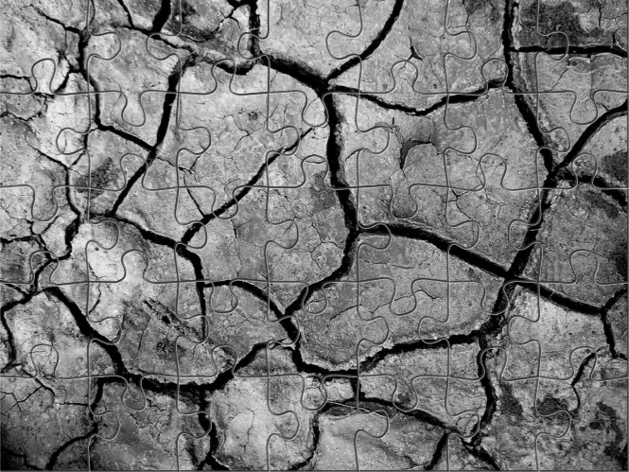
Brief overview of the CCl pieces ….

Slide 3
WMO Programmes
Source: Climate Information for adaptation and development needs, WMO, 2007

Slide 4
National level
State/Provincial level
District level
Communities and Individuals
Current Climate Variability
Future Climate Change
Impacts/Risks/Adaptation
Seasonal
Decadal
Weather scale
Inter-annual
20 – 30 yrs
Climate information requirement for risk management and adaptation actions
Climate, in a narrow sense can be defined as the average weather conditions for a particular location and period of time. Described in terms of statistical tendencies and variability ..

Slide 5
Started activities in 1929, under IMO
In the 1935 meeting, the period 1901-1930 was adopted as the baseline against which to measure climate fluctuations
Reestablished under WMO during the first WMO Congress in 1951
First meeting 1931, Innsbruck, Chaired by President H. von Ficker (Germany)
Source: CCl, Over eighty years of service, WMO, 2011

Slide 6
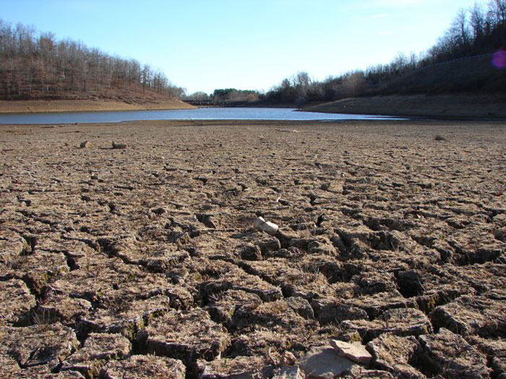
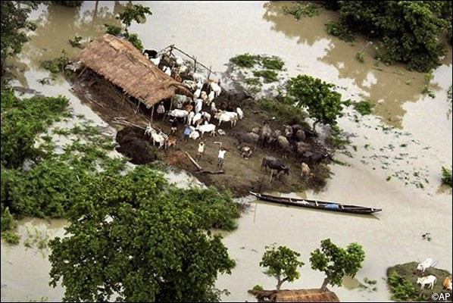
Consider a city running low on drinking water during a drought/or villages flooding
Strategies for city’s long-term water planning or flood risk reduction
Slides from: Dr. Tom Peterson, President, CCL

Slide 7
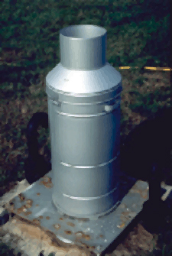
Climate information needs
Is this is a once in 200 years drought or a once in 20 years drought?
What do the seasonal forecasts say?
What measures can be taken to adapt to the risks?
  The Commission for Climatology has 4 Panels that helps NMHS’s know how to answer these questions
    Open Panel of CCl Experts (OPACEs)

Slide 8
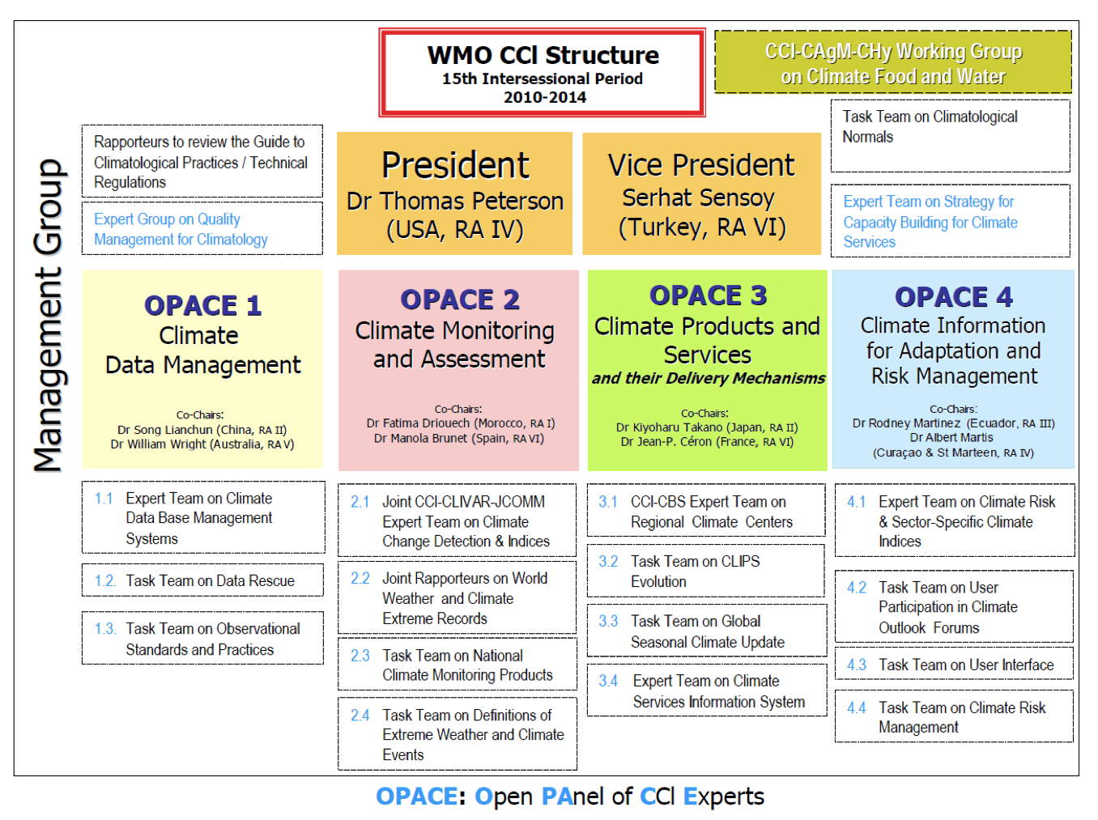

Slide 9
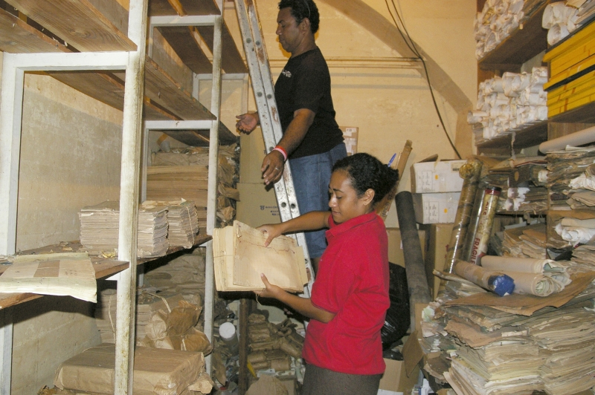
1. Historical data
Are the original observations on paper forms rescued and digitized?
Are the data managed in such a way that you can get easy access to them?
  These are the domain of CCl Panel I: Climate Data Management

Slide 10
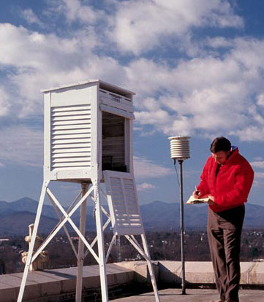
Panel I highlights
Developing a Data Rescue portal
Climate Database Management Systems
  Improving functionality; interoperability, exchange
  Guidelines for incorporating data and metadata
Guiding development of Normals
  To make them more useful in an era of changing climate
Climate Observational Standards
  Guidelines, assess capacities

Slide 11



Data Rescue Projects and Initiatives
NOAA Climate Database Modernization Programme – (CDMP) collaborate with private industry to image & key paper records, making them available on the web
International Environmental Data Rescue Organization (IEDRO)– enables the meteorological and scientific communities to provide more accurate severe weather forecasting
MEditerranean climate DAta REscue (MEDARE) - develop, consolidate and progress climate data and metadata rescue activities across the Greater Mediterranean Region
Atmospheric Circulation Reconstructions over the Earth (ACRE) collaboration with a number of international data rescue projects and activities.

Slide 12
About 5000 people died
26 July 2005 Mumbai heavy-rain event that recorded 944 mm rainfall in 24 h with significant spatial variability
Source: Rakecha et al. (1990) Theor. App. Climatol., 41, 213-219

Slide 13
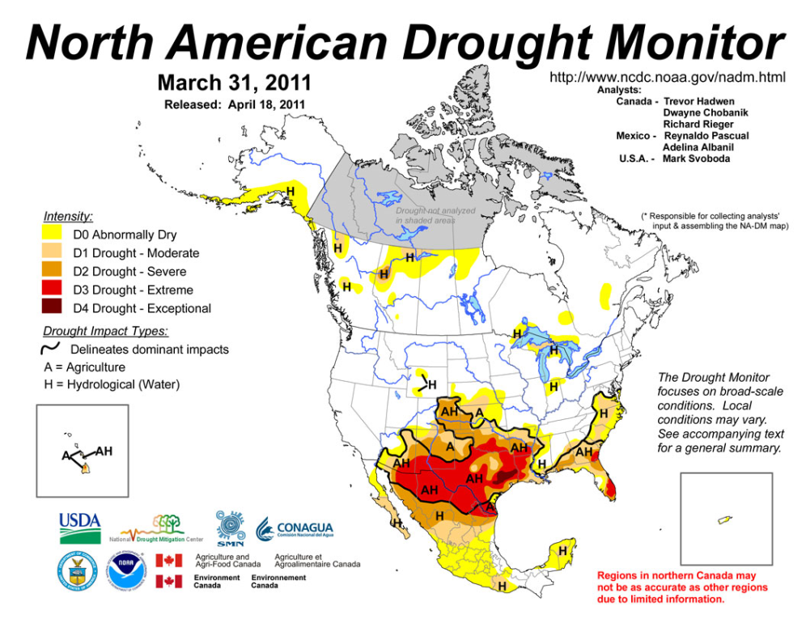
2. Assessing and monitoring
Current extreme into a accurate historical context
Monitoring climatic developments in real time
These are the domain of Panel II: Climate Monitoring and Assessment

Slide 14
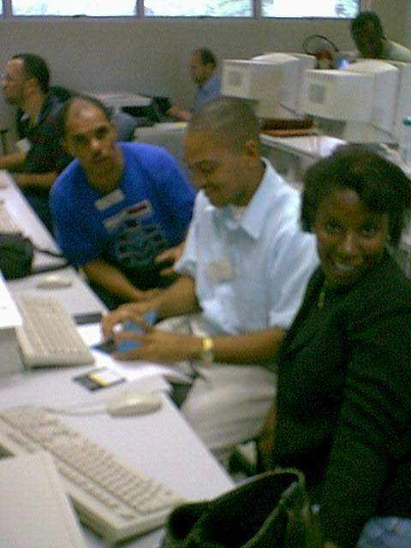
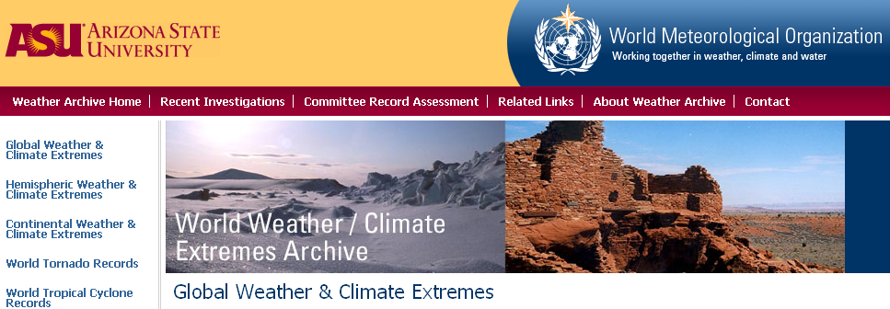
Panel II highlights
Indices of extremes from daily data
  Regional Workshops on analysis of extremes
Internationally coordinating National climate monitoring products
Defining extreme weather and climate events
Official source of world weather and climate records
Annual Statements on
World Climate
wmo.asu.edu

Slide 15
Task Team on Definitions of Extreme
To clearly define extremes climate events.
A review current extreme definitions and methods has be prepared.
Develop inter-operable data base for climate extreme events at regional and national level. Facilitate development of appropriate software tools.
Help evolve guidelines on methodology and standards for defining extreme weather and climate events that are of major societal impacts.

Slide 16
Examples of RClimdex Analysis
(core of 27 climate change indices based on Temp. and Rainfall)
Patuakhali, Bangladesh, QC/QA
Hulhule, Maldives Temp Extremes
Global Trends in probability based 1-day rainfall extremes
Website: http://etccdi.pacificclimate.org/

Slide 17
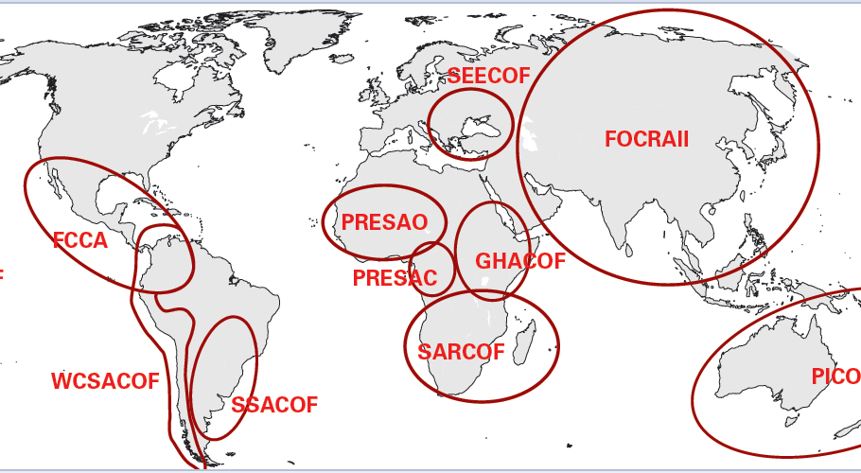
3. Climate Predictions
Do seasonal forecasts predict lessening or worsening of the extreme event?
Can you quickly get access to the most reliable forecast products and disseminate them to your key stakeholders?
  These are the domain of Panel III: Climate Products and Services and their Delivery Mechanism
Regional Climate
Outlook Fora

Slide 18
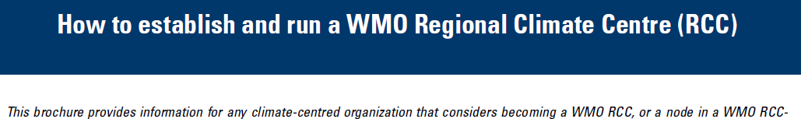
Panel III highlights
Guiding the evolution of Climate Services Information System (CSIS)
Guiding the development of Global Seasonal Climate Updates
  Consensus-based seasonal forecasts
Foster, coordinate and guide Regional Climate Centers

Slide 19
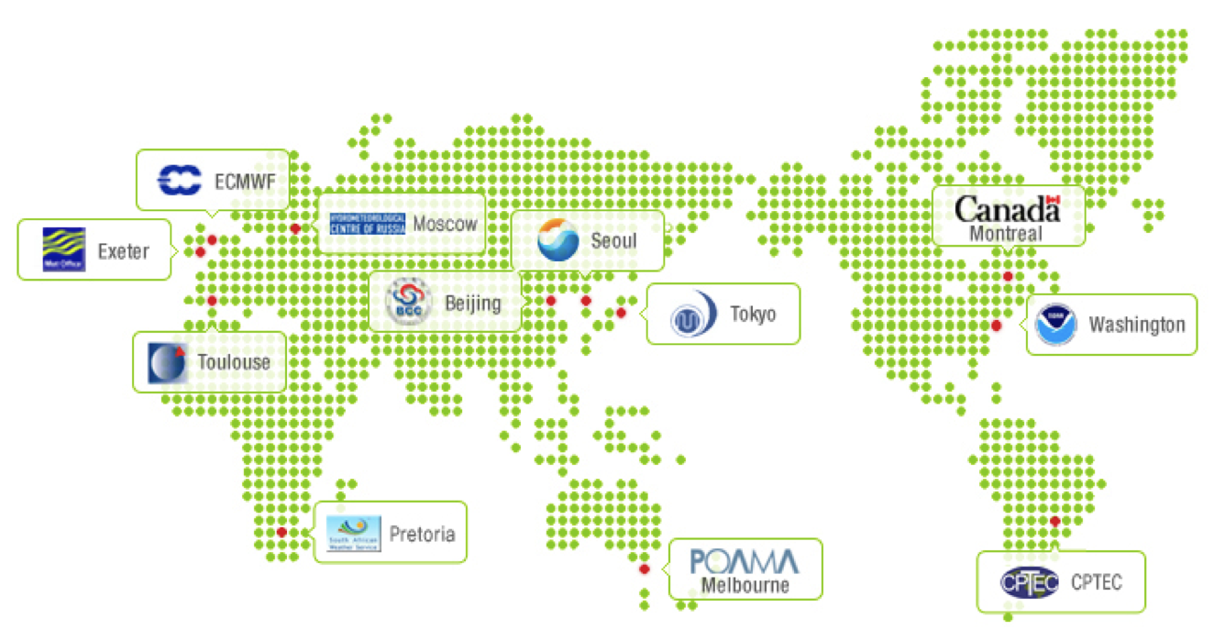
Global Production Centers (GPCs)
In 2006, WMO set up a process to designate centers making global seasonal forecasts as WMO Global Producing Centers (GPCs) of Long Range Forecasts
GPCs adhere to defined standards – aiding consistency and usability of output:
  a fixed forecast production cycle
  a standard set of forecast products
  WMO-defined verification standards (for retrospective forecasts)
A comprehensive set of standard verification measures, with which to communicate the skill of forecasts,

Slide 20
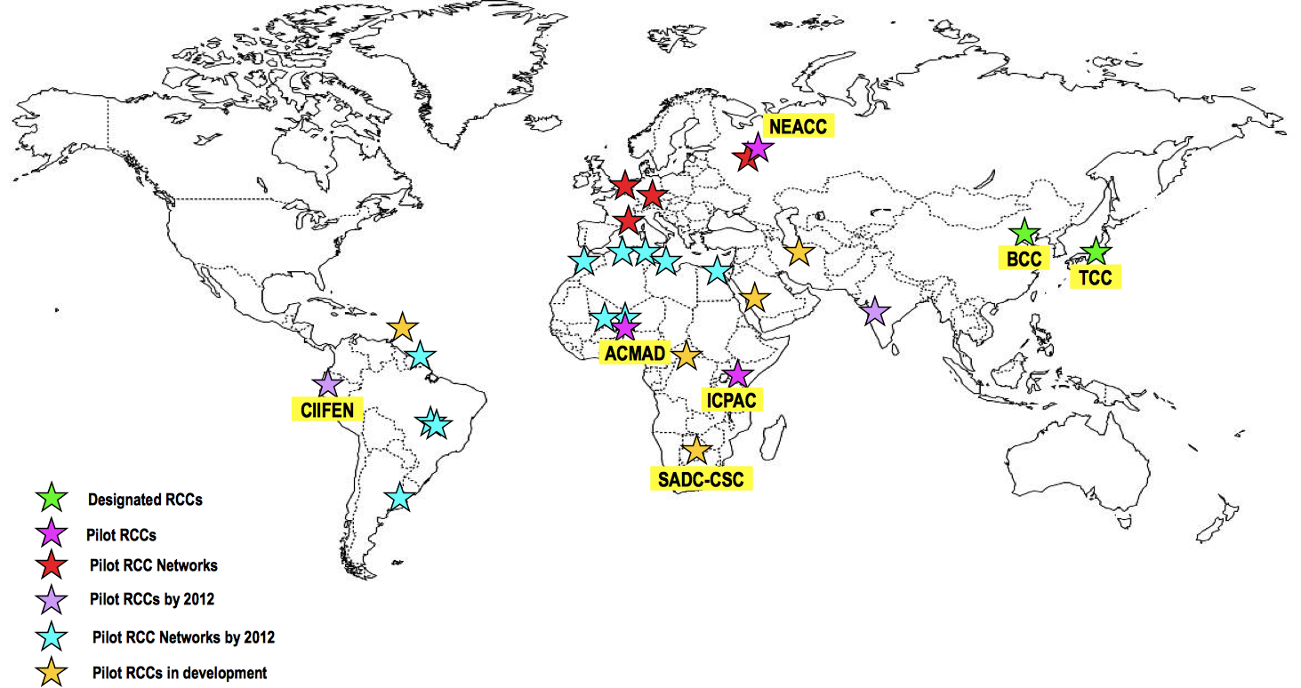
Regional Climate Centers (RCCs)
WMO RCCs are Centers of Excellence performing regional-scale climate functions, designated by CBS and CCl.
Mandatory Functions:
  Operational Activities for LRF
  Operational Activities for Climate Monitoring
  Operational Data Services, to support operational LRF and climate monitoring
  Training in the use of operational RCC products and services
Highly Recommended Functions:
  Climate prediction and projection
  Non-operational data services
  Coordination functions
  Training and capacity building
  Research and development

Slide 21
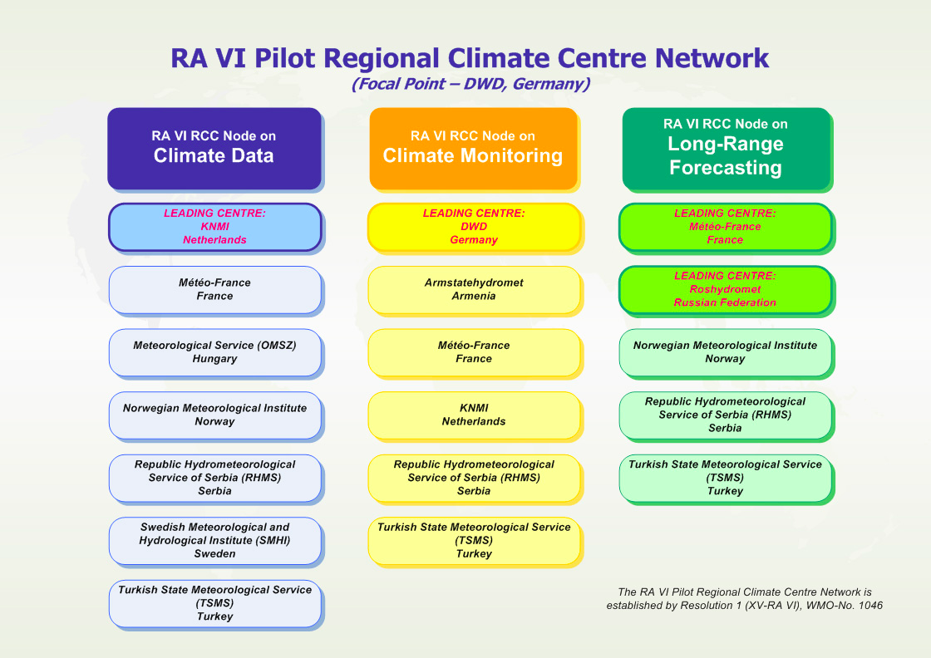
Network RCC: WMO RAVI (Europe)
International Climate Assessment and Dataset (ICA&D) web interfaced platform that enables users to get access to detailed climate data and – tailored – analyses; KNMI Climate Explorer

Slide 22
4. Adapting to climate risks
Assess the risk of the extremes continuing?
Adapt and plan for the relevant risks?
  These are the domain of Panel IV: Climate Information for Adaptation and Risk Management

Slide 23
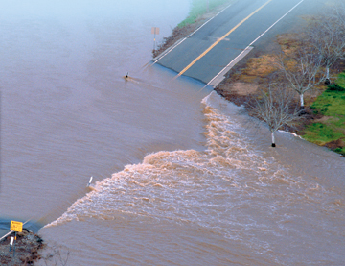
Panel IV highlights
Preparing a document defining Climate Risk Management
Developing socio-economic sector-specific climate indices (CLIMPACT, heat waves, drought)
  Links with CAgM and CHy
Improving user participation in Climate Outlook Forums
Finalizing Heat Waves and Health: Guidance on Warning System Development

Slide 24
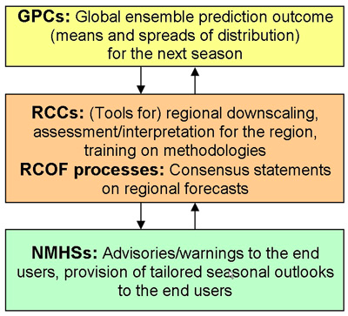
User participation in Regional Climate Outlook Forum
RCOFs have the responsibility to produce and disseminate a regional assessment (using a consensus-based approach) of regional climate for the upcoming season.
Encouraging user participation for climate risk management applications

Slide 25
Additional CCl activities
Finalized the Guide to Climatological Practices
  Now developing an update schedule so it will stay current
Fostering Quality Management for Climatology
Developing cross-panel strategies for Capacity Development for Climate Services
CCl’s works through its volunteers
215 volunteers from 54 Member States

Slide 26
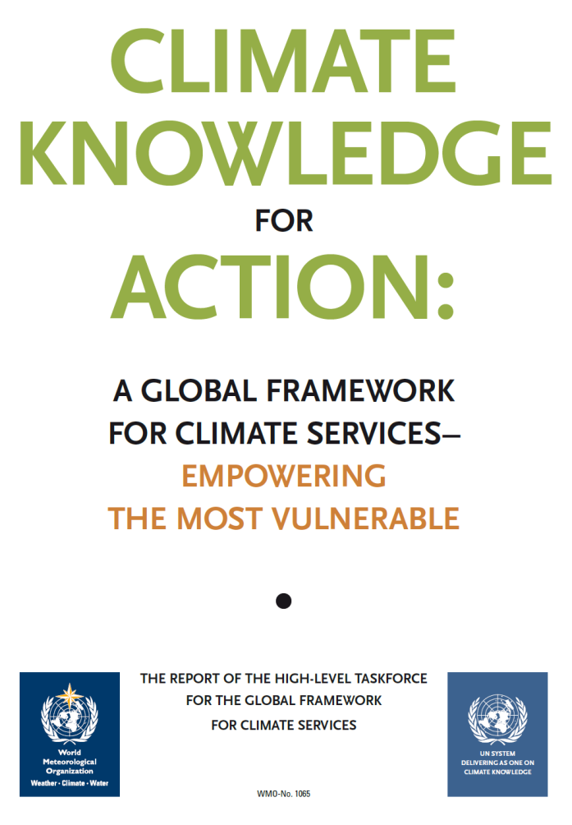
GFCS
Most CCl activities support GFCS in one way or another
CCl will play a key role in GFCS
GFCS will be a major focus of CCl
Improving Climate Services will increase the relevance of CCl’s work

Slide 27
In conclusion many activities of the CCL link to Data, Monitoring and Analysis pertaining to climate extremes or potential hydro-met hazards

Slide 28

…thank you
Notes:
28

